Slide 1

PowerProxy for Azure OpenAI
Timo Klimmer
Global Blackbelt, AI Microsoft

Slide 2
Note: This deck is frequently updated.
You will find the most recent "published" deck on GitHub.

Slide 3






Scalability
TPM limits & Managed PTU
Handle Peak Demands
Request Prioritization
Realtime performance parallel to batch processing
Multitenancy
Cross-Charging Costs
Limit Rates By Team/Use Case
Team/project-specific access to models
Custom Content Filtering
Custom Monitoring
Performance Optimization

Slide 4

PowerProxy for Azure OpenAI
Team or Project 1
AOAI Endpoint/Deployment (PTU or PAYG)
...
...
Team or Project n
AOAI Endpoint/Deployment (PTU or PAYG)
PowerProxy
Python-based open source "solution accelerator" on GitHub by Microsoft's AI GBB team and friends
Monitors and processes traffic to and from Azure OpenAI Service endpoints
Smart Load Balancing
Track consumed tokens by team or use case
Limit TPM by team or use case
Transparent = no code changes required + streaming responses are supported
Provided "as is" = Free for use and modification. Not an official Microsoft product, but supported as if it was developed by customer or partner.
Team or project-specific access restriction to deployments
Performance Optimization
...and more

Slide 5



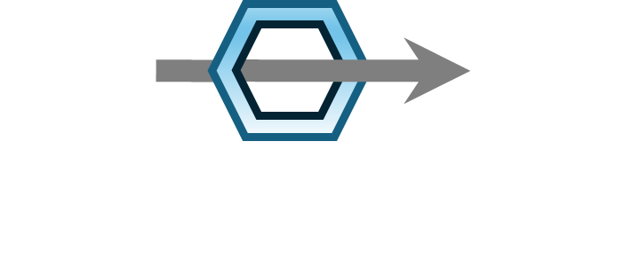





Scenario: API Key Authentication
connection to PowerProxy as if it was Azure OpenAI
Azure OpenAI key = team-specific key
Team or Project 1
optional:
secrets from Key Vault
Key Vault
Azure OpenAI key
(only known to administrators)
Azure OpenAI Service
Team or Project 2
transparent server,
running on arbitrary host, eg. auto-scaling Container Apps
customizable via plugins
Team or Project n
Log Analytics
Power BI

Slide 6
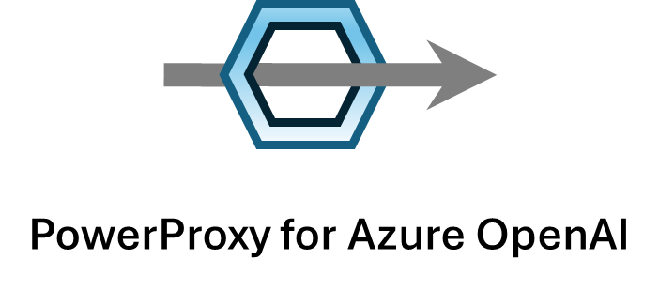
Scenario: Azure OpenAI Azure AD/Entra ID Authentication
Token acquired from Azure AD
for specific user
Token acquired from Azure AD
for specific user
URL is specific for team/project 1
Team or Project 1
team/project is fixed per proxy instance
traffic processed by plugins, eg. to log to Log Analytics
Azure OpenAI Service
Token acquired from Azure AD
for specific user
Token acquired from Azure AD
for specific user
URL is specific for team/project 2
Team or Project n
team/project is fixed per proxy instance
traffic processed by plugins, eg. to log to Log Analytics

Slide 7
Worth To Note
Smartly load balances across endpoints and deployments.
Works on any hosting service that runs Python and/or Docker, for example Azure Container Apps or Kubernetes.
GitHub repo has example deployment script for Azure Container Apps.
Extremely fast due to asynchronous processing and minimal set of Azure services being involved. Low extra cost and latency. Example: 6.300+ Requests per Second @ < 11ms in P90
Built for distributed - scales out by running multiple workers and containers in parallel
Plugin architecture. Highly customizable. Python is commonly known programming language.
More details and starting point at:
👉 GitHub: timoklimmer/powerproxy-aoai
👉 Medium: PowerProxy for Azure OpenAI

Slide 8
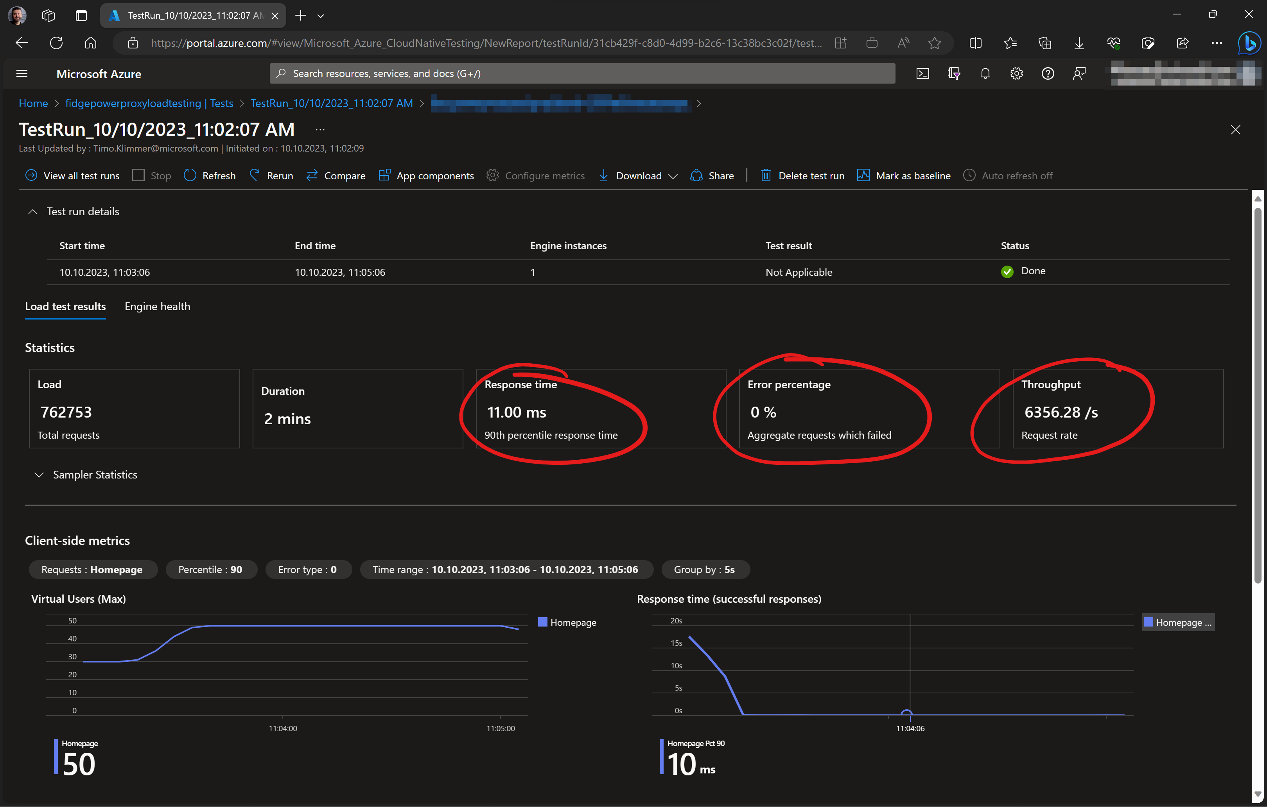

Proven scalability of PowerProxy running on Container Apps using auto-scale

Slide 9
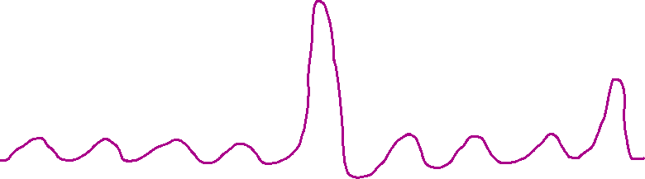
Smart Load Balancing
✔️ Spike demands handled
✔️ Managed PTU before PAYG
✔️ Realtime before Batch
✔️ Across endpoints
✔️ Across deployments
PAYG Deployment 3
PAYG Deployment 2
PAYG Deployment 1
Tokens per Minute
streaming + non-streaming
streaming
Managed PTU Deployment
Time

Slide 10
incoming request
AOAI Endpoint or
Deployment 1
example: Managed PTU, region 1
capacity for streaming requests
capacity for streaming + non-streaming requests
on non-streaming request: "roll dice" and decide if request is passed to
next endpoint/deployment or not (configurable ratio), to reserve capacity
for streaming requests
on 429, 500 or if endpoint/deployment is known to be at capacity,
else return result to client
AOAI Endpoint or
Deployment 2
example: PayGo, region 1
capacity for streaming requests
on non-streaming request: "roll dice" and decide if request is passed to
next endpoint/deployment or not (configurable ratio), to reserve capacity
for streaming requests
capacity for streaming + non-streaming
on 429, 500 or if endpoint/deployment is known to be at capacity,
else return result to client
AOAI Endpoint or
Deployment 3
example: PayGo, region 2
capacity for streaming + non-streaming
Note: Some features like the Assistants API require all deployments to be placed in one single AOAI workspace because the workspace might hold a state.
return a 429 if none of the endpoints/deployments was available to handle the request,
else return result to client

Slide 11
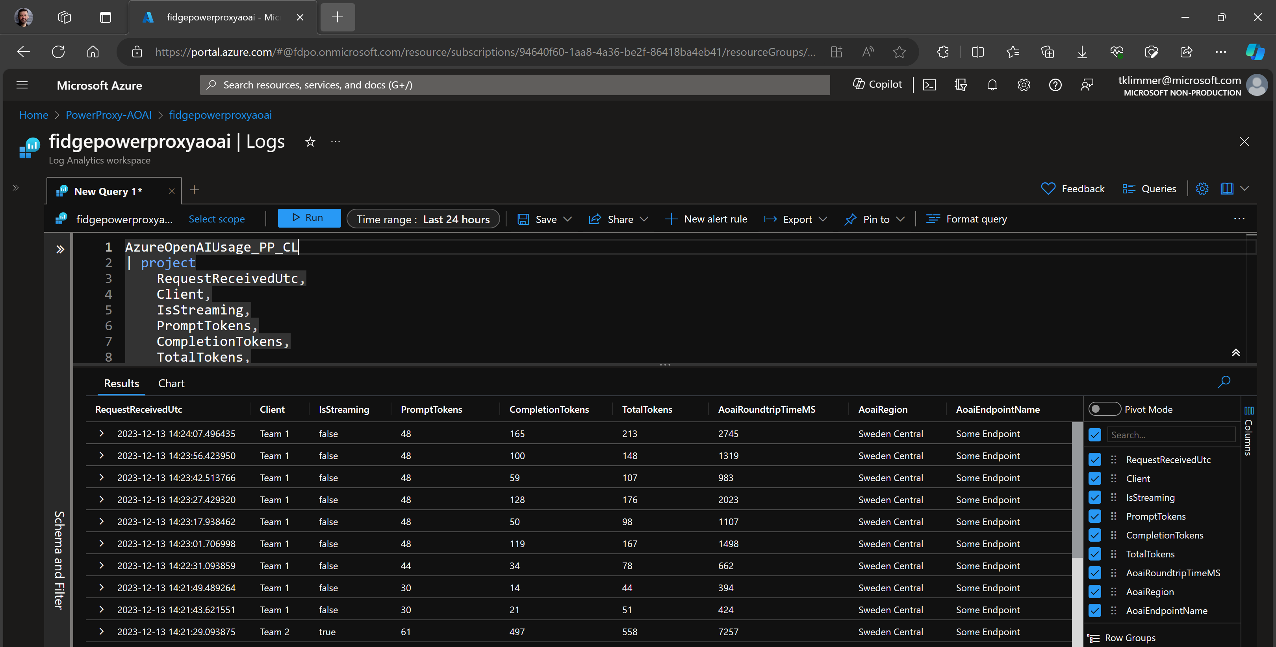
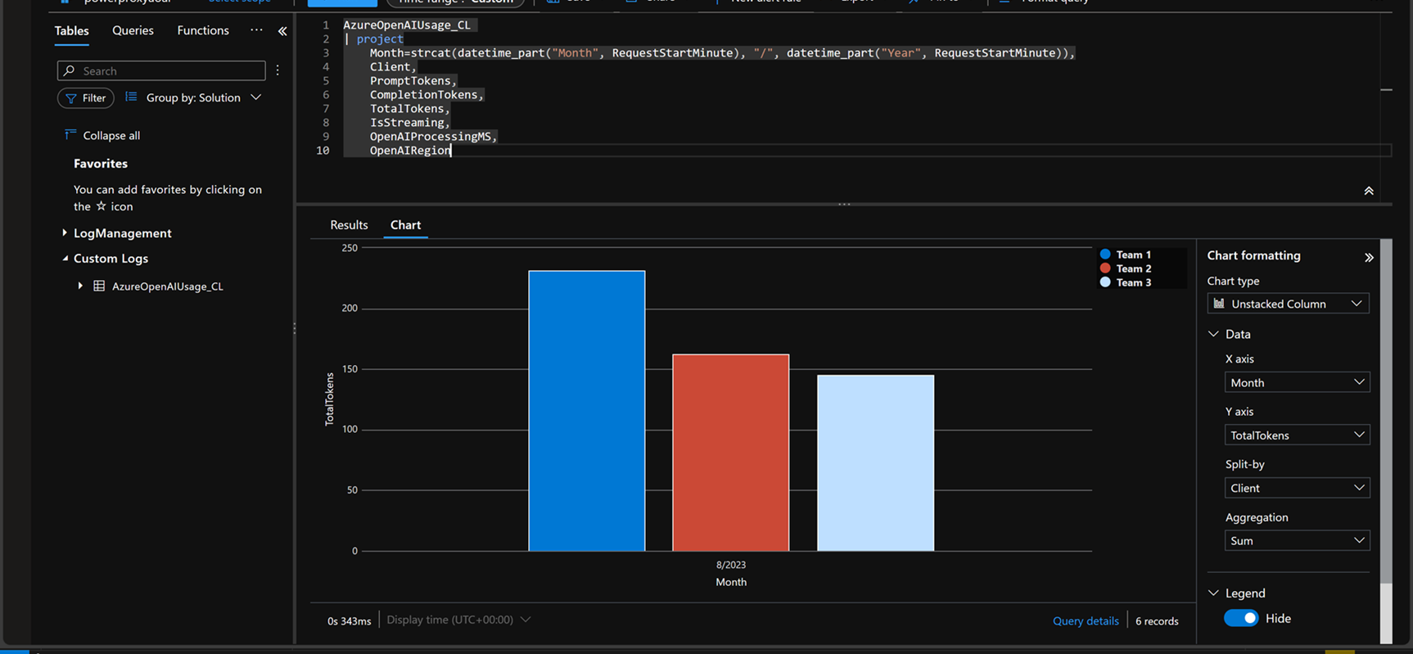
Consumed Token Tracking By Team / Use Case
Cross-Charge Costs
Forecast Required Tokens
Optimize settings
Pivot Chart
Custom Log Analytics Table
Request time, Client (=Team/Use Case), PromptTokens, CompletionTokens, TotalTokens, IsStreaming, Roundtrip Time, AOAI Region, AOAI Endpoint

Slide 12
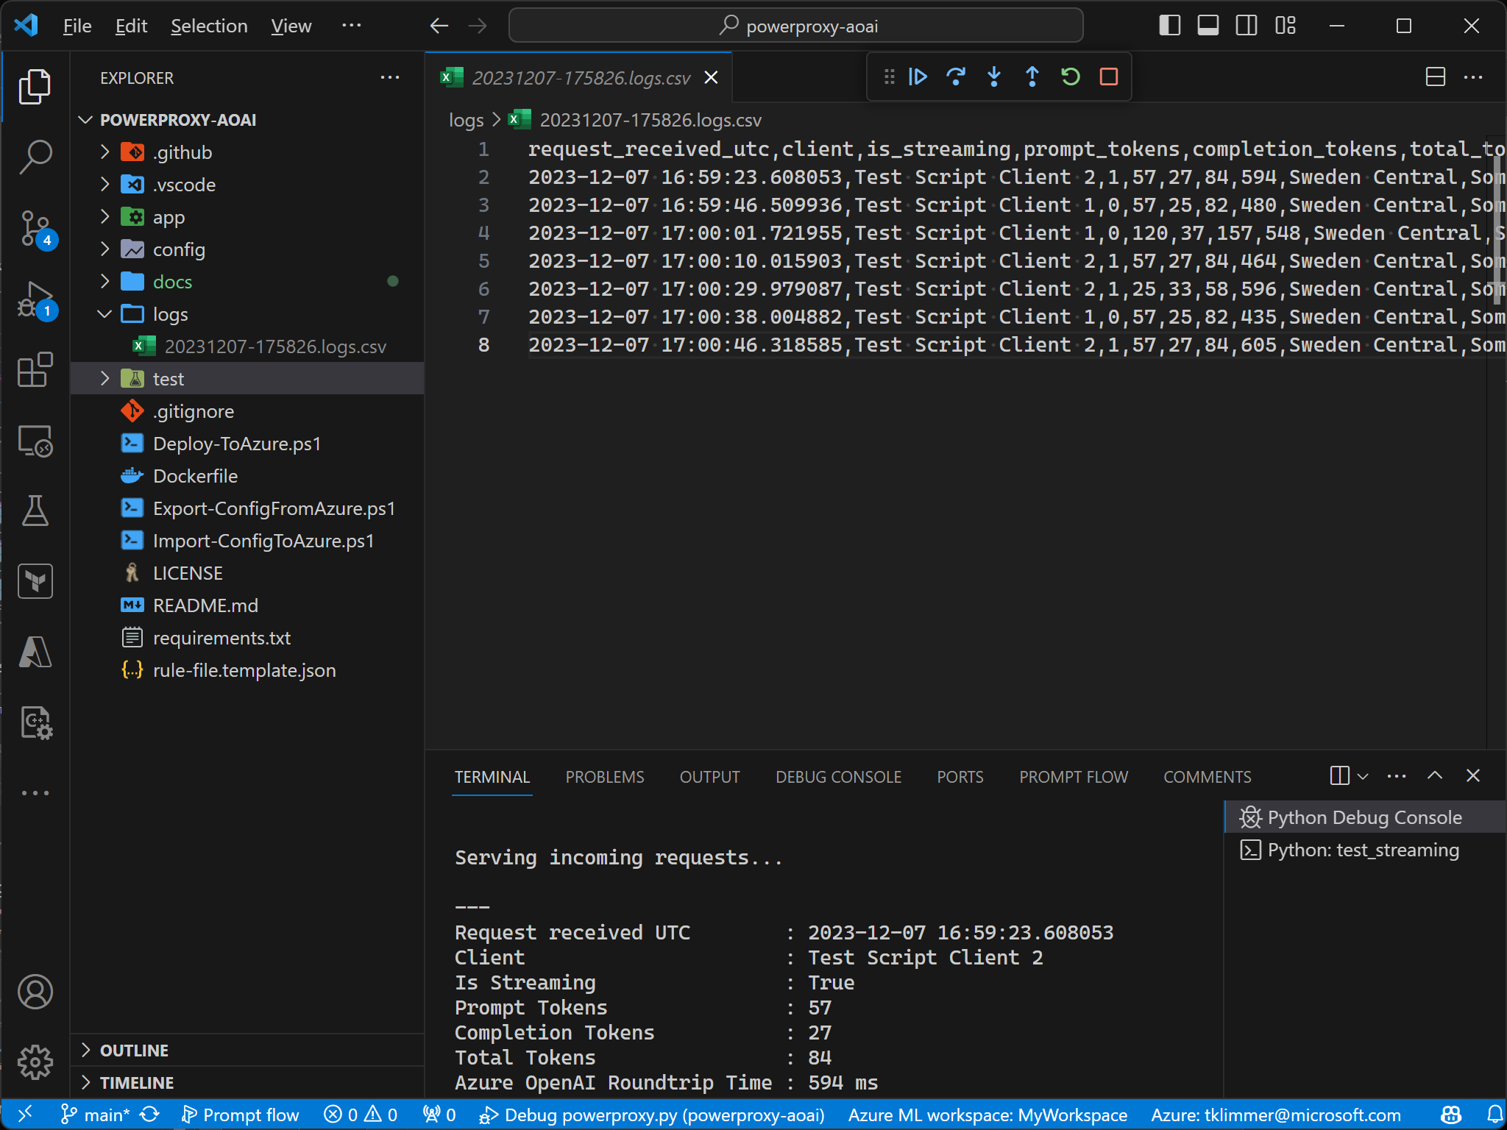
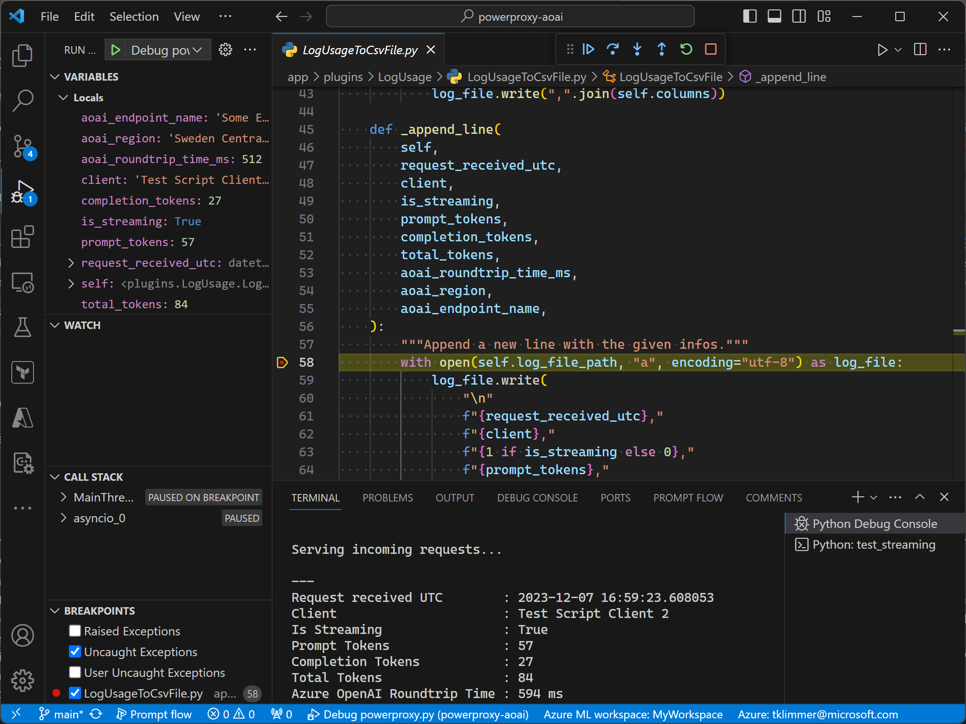
Development and Debugging Tool
Consumed Tokens in CSV file
Debug traffic/plugins on-the-fly

Slide 13
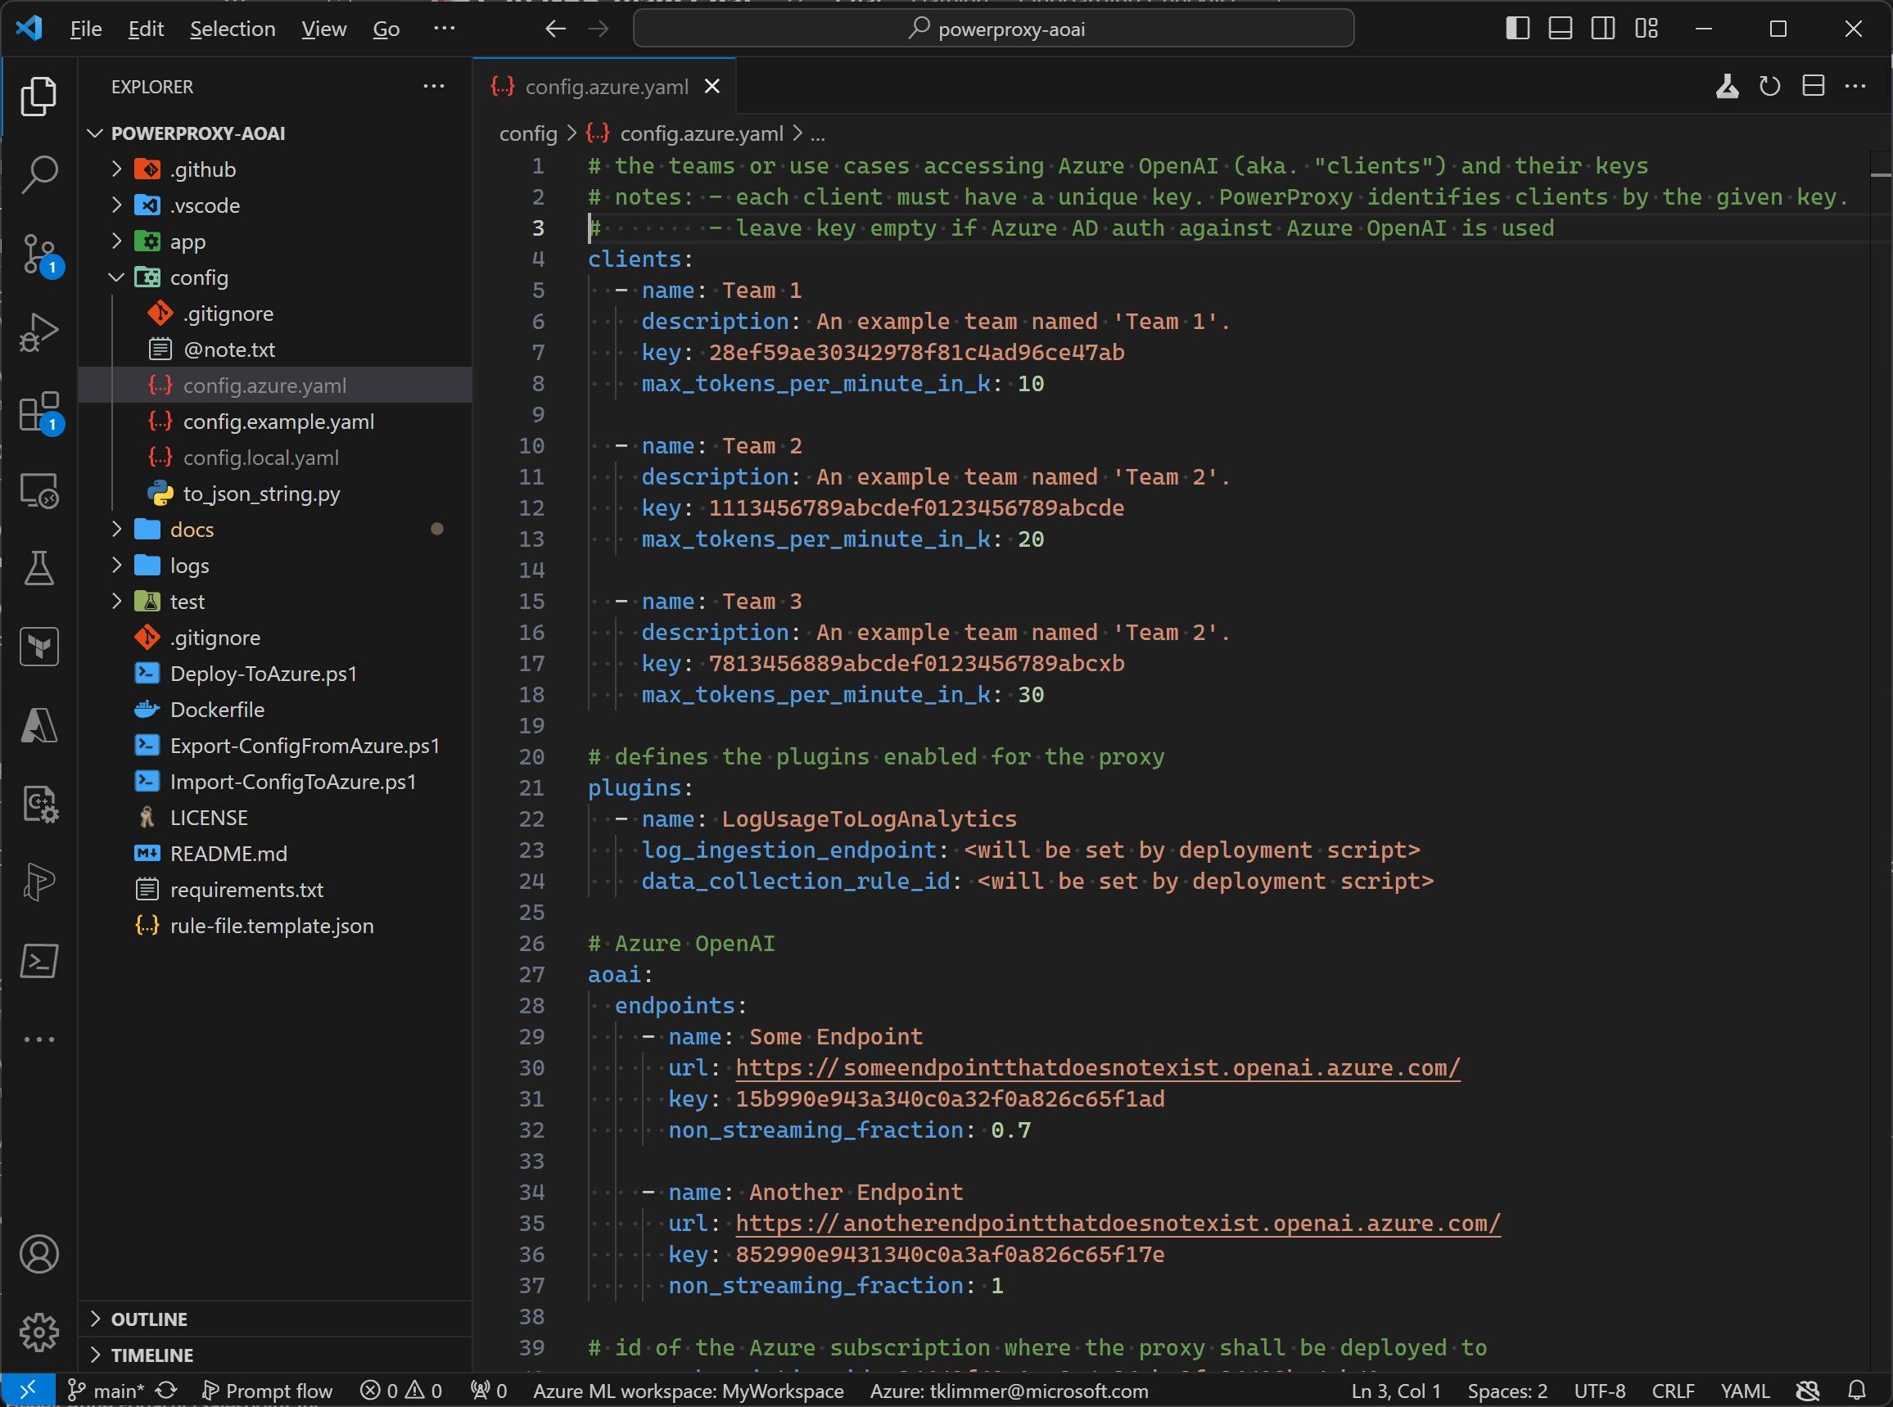
Configuration
list of teams / projects ("clients")
Plugin-specific configuration options per client
For example: Maximum number of tokens per client,
which models can the client access, etc.
pre-built or custom plugins
Extend PowerProxy's capabilities as needed
list of endpoints or deployments
higher endpoints or deployments are prioritzed
load-balancing across deployments is possible
- configurable fraction of non-streaming requests
being served

Slide 14
Q&A
Time to discuss - share your thoughts!

Slide 15
Final slide with logo

